Slide 1
Hyper-network Deblurring
Tal Levitan
Michael Feldman

Slide 2
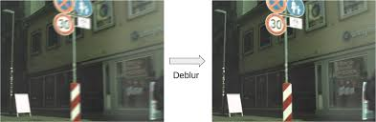
Goal
Deblurring
Small model (Param<1M)

Slide 3
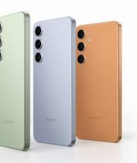
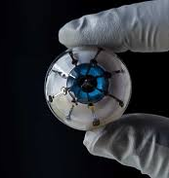
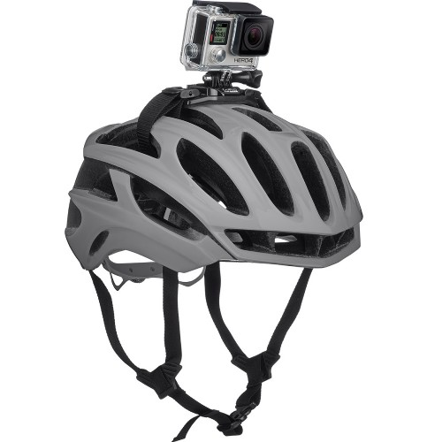
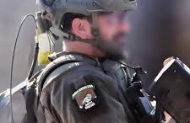
motivation
Denoise images
cheap
Small device
Disconnected to internet

Slide 4
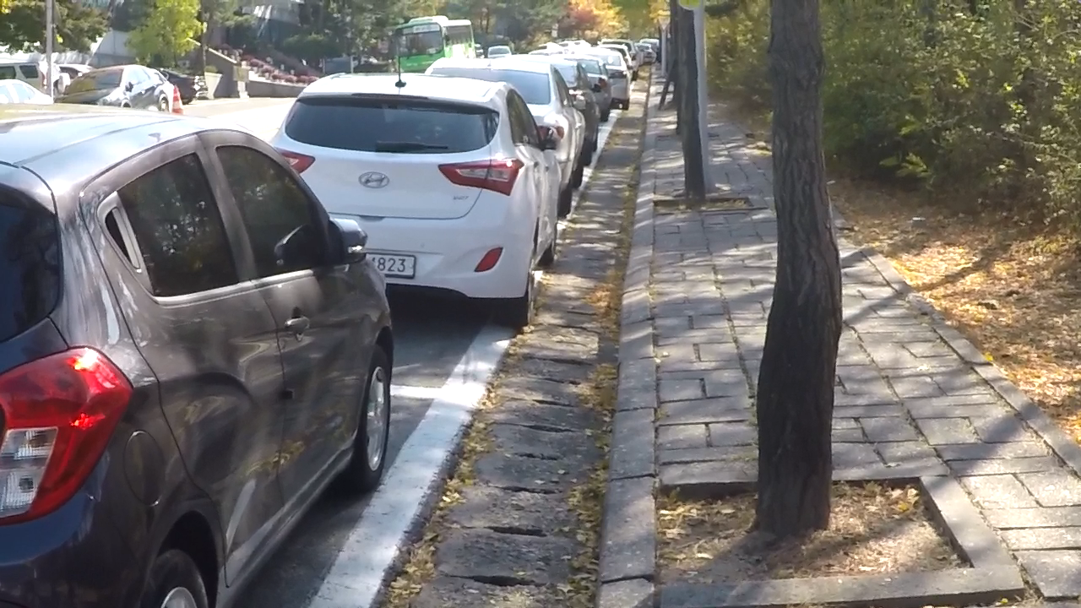



Model (base on “Supervised and Unsupervised Learning of Parameterized Color Enhancement”)
H- CNN
target
$$θ(x)$$
downscale
LOSS
Parametric
transformations
$$G_{x}$$
output
input
Notes:
Difference from most models – learning a global transformation

Slide 5

Data set
GoPro Data-set from Kaggle (https://www.kaggle.com/datasets/rahulbhalley/gopro-deblur)
2000 pair of image to train (80% train 20% validation)
1000 pair of image to test

Slide 6
Experiments: Learn the parameter of the Transformation
Only on color channels
Quadratic nearest neighbor pixels with various LOSS function
MSE LOSS
L1 LOSS (Huber)
Perceptual LOSS (Vgg)

Slide 7
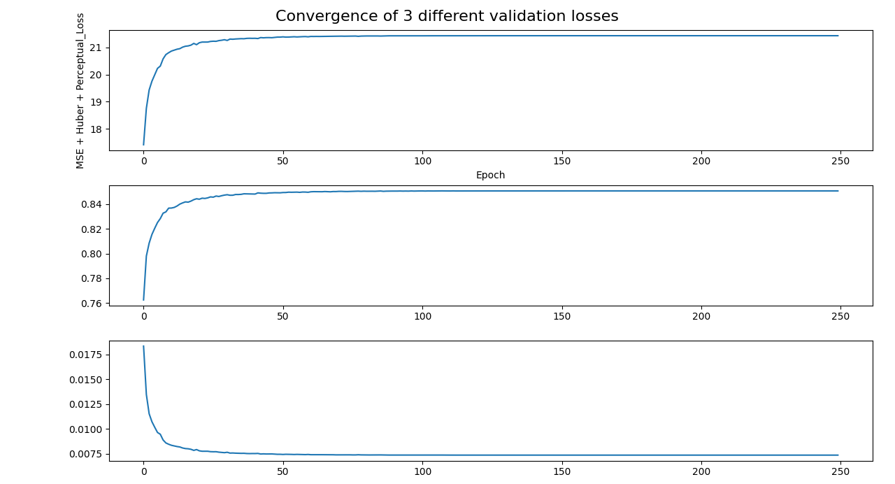
Result- measurement
PSNR -Validation
SSIM - Validation
LOSS - Train

Slide 8

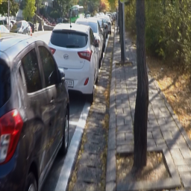

Result
Ground truth
Our prediction
blur

Slide 9

Result- image -focus
Ground truth
Our prediction
blur

Slide 10
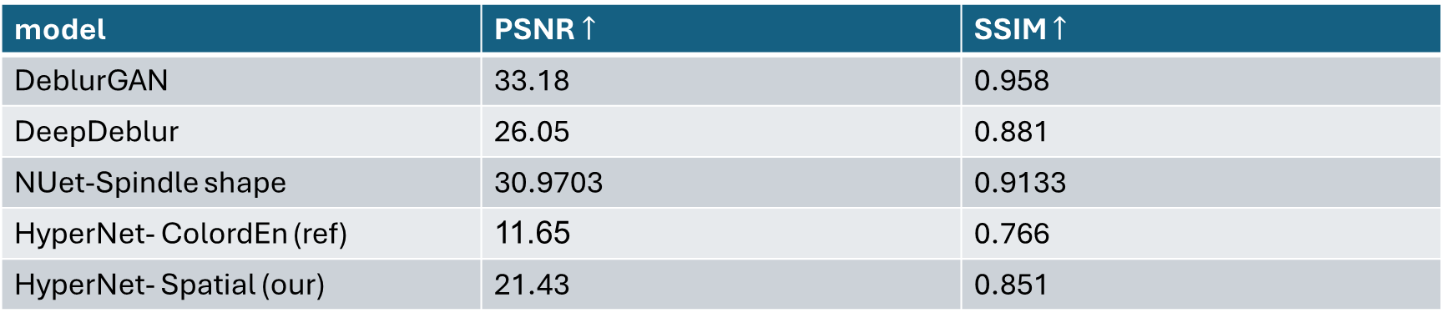
Compere to other models
model | PSNR$↑$ | SSIM $↑$
DeblurGAN | 33.18 | 0.958
DeepDeblur | 26.05 | 0.881
NUet-Spindle shape | 30.9703 | 0.9133
HyperNet- ColordEn (ref) | 11.65 | 0.766
HyperNet- Spatial (our) | 21.43 | 0.851

Slide 11
Conclusions
Problem:
Too small dataset
Simplistic – model required more information.
Future work:
Find better hyper parameter
Find better global - transformation
Different Dataset
Another noise

Slide 12
Questions

